Slide 1


SMART INDIA HACKATHON 2025
TITLE PAGE
Problem Statement ID – SIH25026
Problem Statement Title – Develop API code to integrate NAMASTE and or the International Classification of Diseases (ICD-11) via the Traditional Medicine Module 2 (TM2) into existing EMR systems that comply with Electronic Health Record (EHR) Standards for India.
Theme - MedTech / BioTech / HealthTech
PS Category- Software
Team ID -
Team Name (Registered on portal) - CodeTech

Slide 2

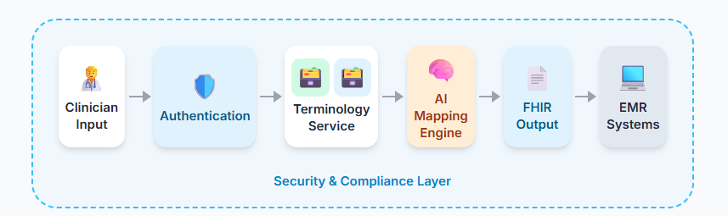
AYUSHSetu(आयुषसेतु)
KHAN SURAKSHA (खन सुरक्षा)
1. Unified Terminology Service
Doctors can search AYUSH (NAMASTE) and ICD-11 codes in one place.
(Powered by FHIR-compliant microservice)
2. AI-Powered Dual Coding
Automatically maps AYUSH codes to ICD-11 with explanations.
(Enabled via Vector DB + LLM engine)
3. Smart Auto-complete
Suggests relevant codes instantly as the doctor types.
(Delivered through RAG-based search APIs)
4. Seamless EMR Integration
Outputs dual-coded diagnosis directly into hospital EMRs.
(Exported as FHIR Bundle / ProblemList)
5. Secure & Compliant
Every action is authenticated via ABHA ID and logged.
(OAuth2 + Audit trails)
6. Doctor-Friendly Demo UI
Simple interface for clinicians to try search, mapping, and EMR export.
(Built with ReactJS frontend)
Figure No 01 - Use Case Diagram
2

Slide 3

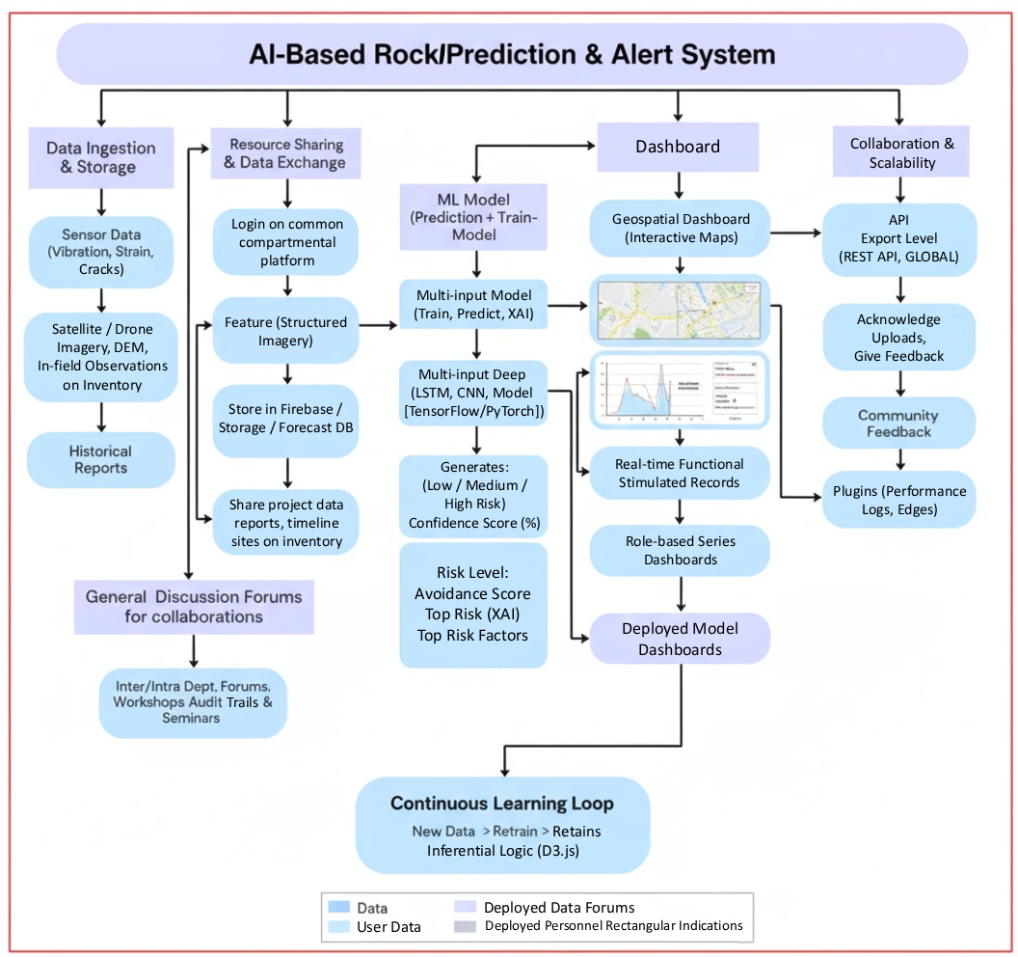
TECHNICAL APPROACH
Figure No 02 - Process Flow Diagram
TECH STACK
  Frontend: React.js + Vite, Tailwind CSS
  Backend: Django REST Framework / FastAPI (Python-based, AI-friendly)
  Database & Hosting: Firebase (Firestore / Realtime DB) + AWS S3 / GCP Storage (for sensor & drone data)
  Real-time Communication: Firebase Realtime DB / WebSockets (Socket.IO)
  AI/ML Integration: TensorFlow / PyTorch, Scikit-learn, SHAP/LIME (Explainable AI)
  Geospatial & Mapping: Leaflet.js / Mapbox GL JS, GDAL, Rasterio
  Data Visualization & Reporting: D3.js / Plotly.js / Chart.js
  Alerts & Notifications: Twilio / Fast2SMS (SMS), Firebase Cloud Messaging (Push), python-telegram-bot (Telegram/WhatsApp)
  Security & Authentication: Firebase Authentication (Email/OTP/MFA)
  Edge/Offline Deployment (Optional): TensorFlow Lite / ONNX Runtime
  DevOps & Deployment: Docker, GitHub Actions, AWS/GCP free credits
3

Slide 4



FEASIBILITY AND VIABILITY
Analysis of Feasibility
Potential Risk and Challenges
Strategies for Overcoming Challenges
Technical:
Technological:
Technical:
Proven availability of AI/ML frameworks for prediction.
Existing tools for drone/sensor data collection.
Cloud platforms support scalability and storage.
Sensor/drone data
Integration of diverse data types\
Real-time processing latency
Bias or underfitting
Edge computing, hybrid models, data augmentation, explainable AI
Organizational:
Operational:
Economic:
Resistance from mine staff due to fear of job replacement.
Lack of trained manpower to maintain the system.
Data-sharing hesitancy from private mining companies.
Compliance with Indian mining regulations.
Provide role-based dashboards.
Start with pilot mines → build trust & show benefits before scaling.
Conduct training sessions for workers and supervisors.
Ensure government partnership for regulatory compliance & adoption.
Low-cost sensors & drones
Software licensing cost
software licensing cost
Huge economic losses
Operational:
Mobile dashboards, govt. familiarity, phased adoption possible.

Slide 5
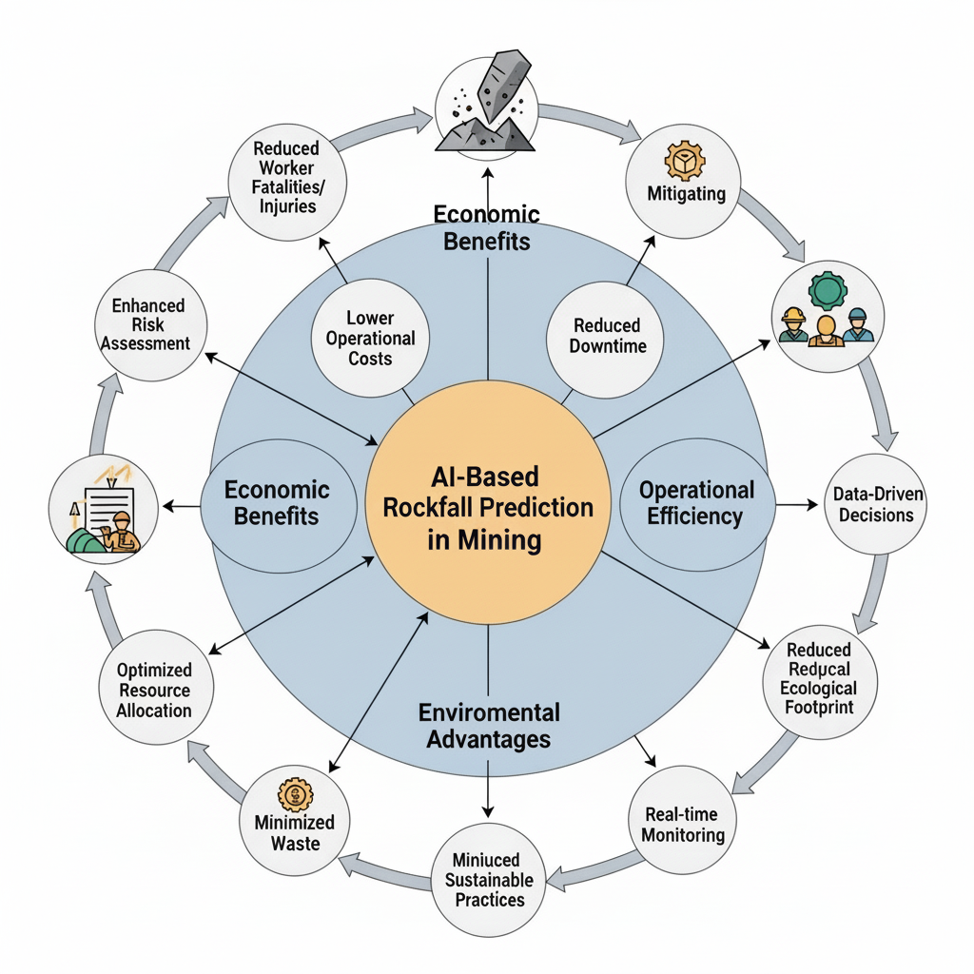
IMPACT AND BENEFITS
Potential Impact on Target Audience
Mine safety Officers:
Real- time hazard alert for quick action.
Automated Monitoring reduces manual workload.
Data driven insights for excavation & blasting plans.
Mine Workers:
Life saving alerts (SMS / WhatsApp).
Increased trust & Morale due to safer environment.
Access to training & safety guides in simple format
Government & Regulatory Authorities:
Easier compliance with mining safety laws.
Transparent monitoring via centralized data reports.
Data helps improve mining safety policies.
Local Communities & Families:
Safer environment with fewer disasters.
Peace of mind for workers’ families.
Stronger social & economic stability in mining regions.

Slide 6
RESEARCH AND REFERENCES
References
1. M. Senanayake, G. J. N. L. P. D. S. D. G. T. H. C. Jayawardana and S. D. G. T. H. C. J. H. L. G. D. M. S. C. J. K. U. V. D. S. C. Jayawardana, "Prediction of rockfall hazard in open pit mines using a regression based machine learning model," *Journal of The Institution of Engineers, Sri Lanka*, vol. 57, no. 1, pp. 24–33, 2024.
L. Qing, Y. Lu, Y. Hu, and C. Liu, "Intelligent Prediction and Numerical Simulation of Landslide Prediction in Open-Pit Mines Based on Multi-Source Data Fusion and Machine Learning," *Sensors*, vol. 25, no. 10, p. 3131, 2025.
J. R. Andrew, H. J. Hume, R. Bartingale, and A. Rock, "Observation of Rockfall in the Thermal Infrared." *ResearchGate*, 2024.
D. H. Kim and I. Gratchev, "Application of Optical Flow Technique and Photogrammetry for Rockfall Dynamics: A Case Study on a Field Test," *Remote Sensing*, vol. 13, no. 20, p. 4124, 2021.
M. Ghahramanieisalou and J. Sattarvand, "Rockfall Dynamics Prediction Using Data-Driven Approaches: A Lab-Scale Study," *Geotechnics*, vol. 5, no. 1, p. 13, 2025.

